Slide 1
Session 13
DRE Reference Sources

Slide 2
Learning Objectives
Discuss print resources available to assist DREs
Learn about other resources available to assist DREs

Slide 3
Suggested Criteria for Identifying a Reference Source
Less than five years old (by copyright date)
Readily available in print or online
Periodically updated
Utilized by practitioners
At a minimum, contain information on a particular drug’s name, forms, actions, and side effects

Slide 4
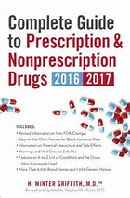
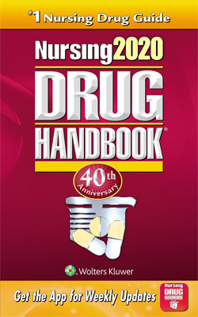
Written Sources

Slide 5
Electronic Sources

Slide 6
Other Information Sources

Slide 7
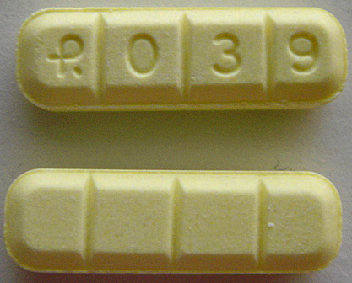
Alprazolam 2mg
Identify this pill

Slide 8
Clonazepam .5mg
Identify this pill

Slide 9
Methylphenidate HCL 20mg
Identify this pill

Slide 10
Venlafaxine HCL
Identify this pill

Slide 11
Oxycodone HCL 5mg/Acetaminophen 325mg (Roxicet)
Identify this pill

Slide 12
Questions?

